Slide 1
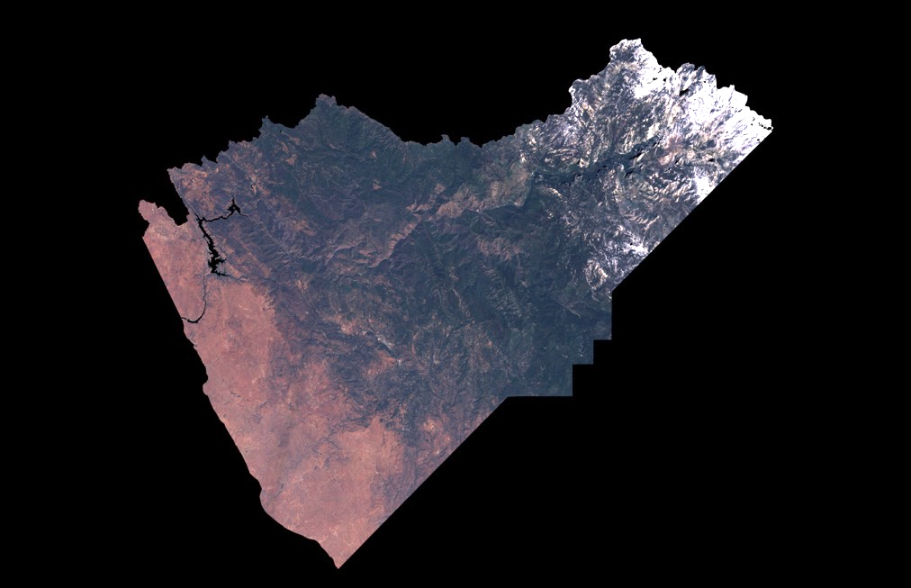
Introduction to spatial data
Christian John, Ph.D.
Postdoctoral scholar
Burkepile lab, UCSB
Copernicus Sentinel data for
Mariposa County, 2015-2017

Slide 2
What is raster data?
A grid of values.
ArcGIS Raster Basics
Notes:
Values may be continuous or categorical; grids can be stacked to form interesting datasets such as RGB imagery.

Slide 3
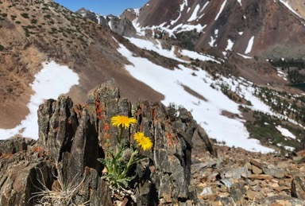
What is raster data?
National land cover dataset
A grid of values.
Elevation of Yosemite National Park
NEON
Notes:
Values may be continuous or categorical; grids can be stacked to form interesting datasets such as RGB imagery.

Slide 4
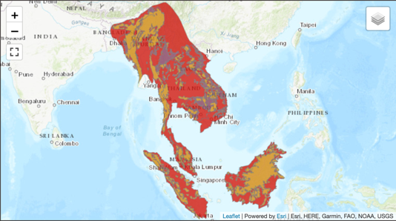
… as opposed to vector data
Points, lines, and polygons
Geographic range of Sun Bear
IUCN
US NPS

Slide 5

Coordinate reference system
Mathematical “flattening” of earth’s surface to 2 dimensions
Many ways to do this!
Pros and cons to every way
wikimedia
QGIS

Slide 6
Coordinate reference system
Mathematical “flattening” of earth’s surface to 2 dimensions
Many ways to do this!
Pros and cons to every way
wikimedia
wikipedia

Slide 7
Properties of a raster dataset
17
17
Dimensions

Slide 8
Properties of a raster dataset
Extent
122º W
120º W
42º N
*With any two of these, you can calculate the 3rd.
17
40º N
17
Dimensions
Resolution
13 km
13 km

Slide 9
Properties of a raster dataset
Reference system
Extent
122º W
120º W
42º N
17
40º N
17
EarthDataScience
Dimensions
Resolution
13 km
13 km

Slide 10
Today we’ll learn to:
Import spatial data into R
Identify components of spatial datasets
Perform basic operations with raster and vector data
Visualize spatial data

